Slide 1
ARL Notification List
Nathan Bain, Zach Peters, Jerry Dodd

Slide 2
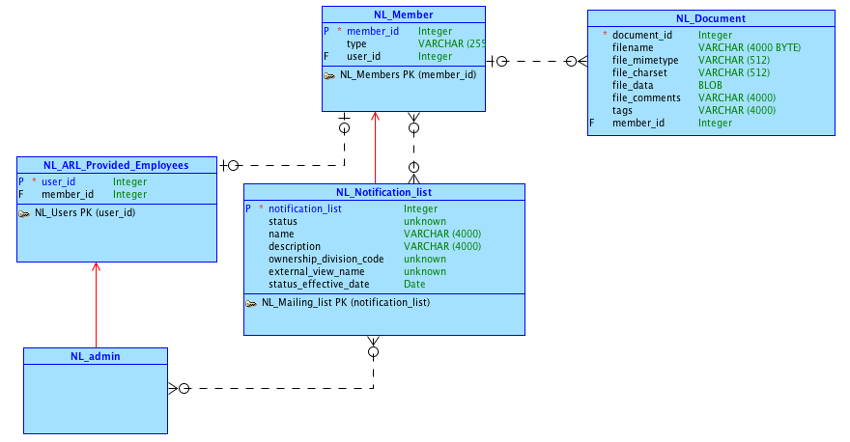
Conceptual Model

Slide 3
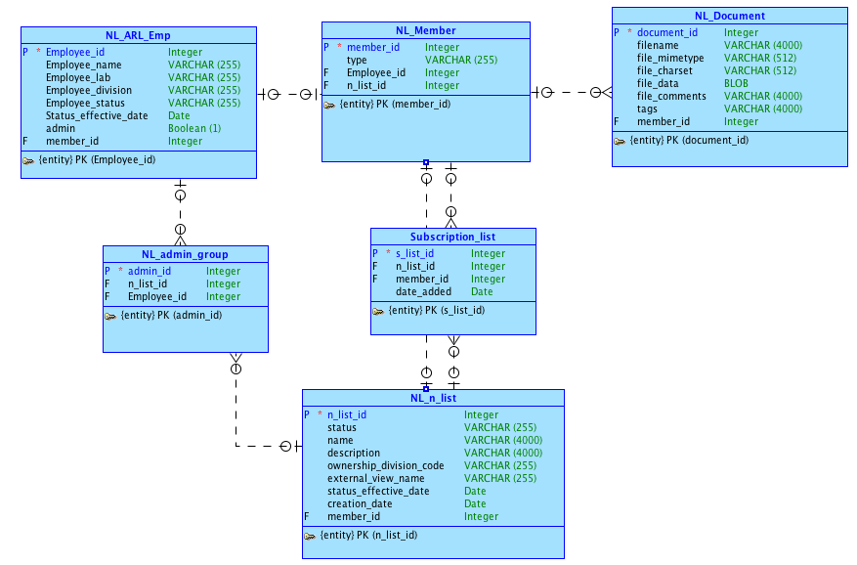
Logical Model

Slide 4
APEX URL
https://apex.oracle.com/pls/apex/f?p=94355:1:112415419871585:::::

Slide 5
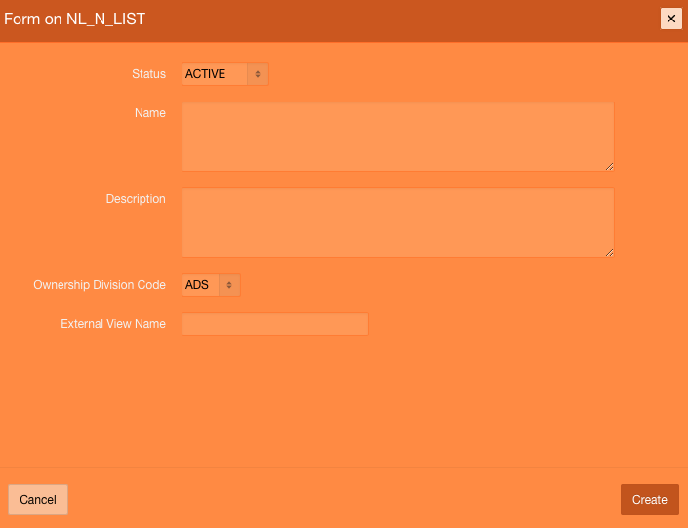
Allows admin users to create new lists with the ownership code matching that of the list creator

Slide 6
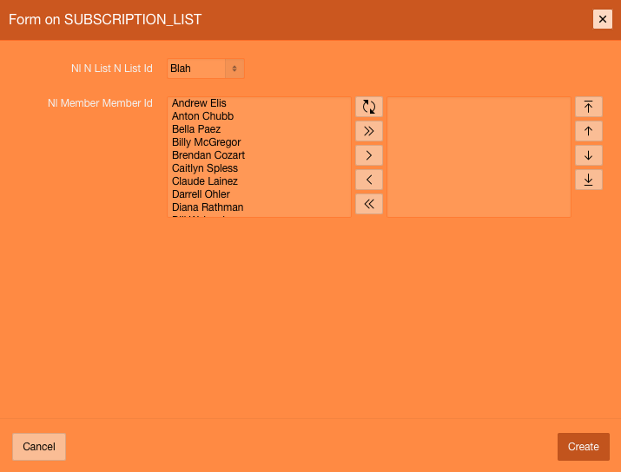
Allows user to add or remove multiple users or lists to another list

